Slide 1
Output Methods
JavaScript can "display" data in different ways:
➢ Writing into an HTML element, using innerHTML.
➢ Writing into the HTML output using document.write().
➢ Writing into an alert box, using window.alert().
➢ Writing into the browser console, using console.log().

Slide 2
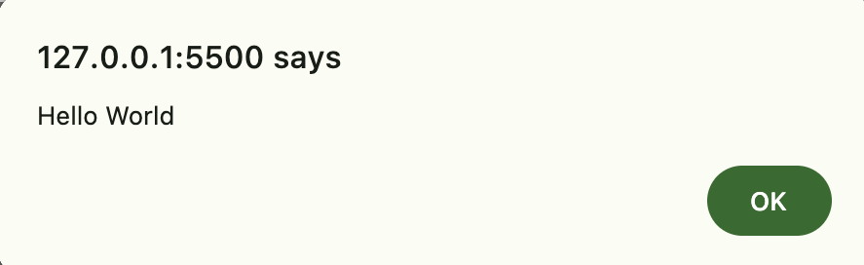
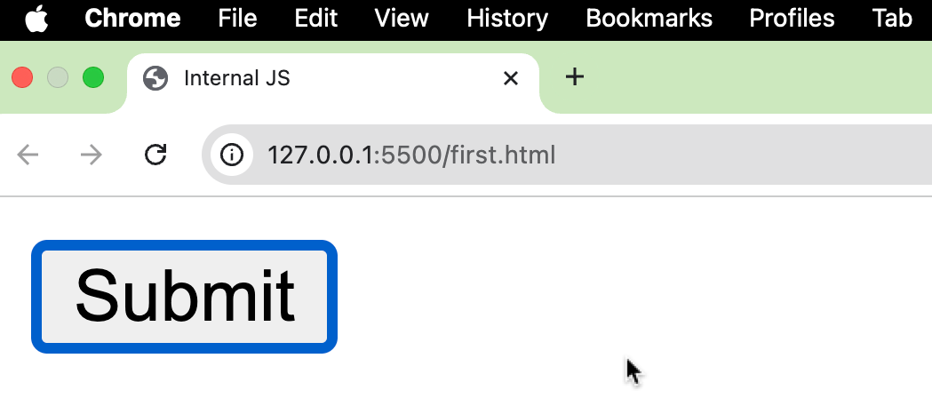
QN 1 Write a Js Program to demonstrate Internal Javascript
/*HTML code Save it as index1.html*/
<html>
<head> <title>Internal JS</title>
<script>
function adish() {
alert("Hello World")
}
</script>
</head>
<body>
<input type = "button" onclick = "adish()" value = "Submit" />
</body>
</html>

Slide 3
QN 2 Write a Js Program to demonstrate External Javascript
/*HTML code Save it as index2.html*/
<html>
<head> <title>External JS</title>
<script src="index2.js">
</script>
</head>
<body>
<input type = "button" onclick = "adish()" value = "Submit" />
</body>
</html>
/*Js code Save it as index2.js*/
function adish() {
alert("Hello World")
}

Slide 4
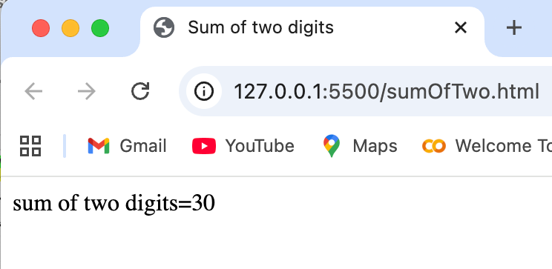
QN 3 Write a Js Program to demonstrate addition of two no:
<html>
<head>
<title>Sum of two digits</title>
</head>
<body>
<script>
var x = 10;
var y = 20;
var z=x+y;
document.write("sum of two digits="+z);
</script>
</body>
</html>

Slide 5
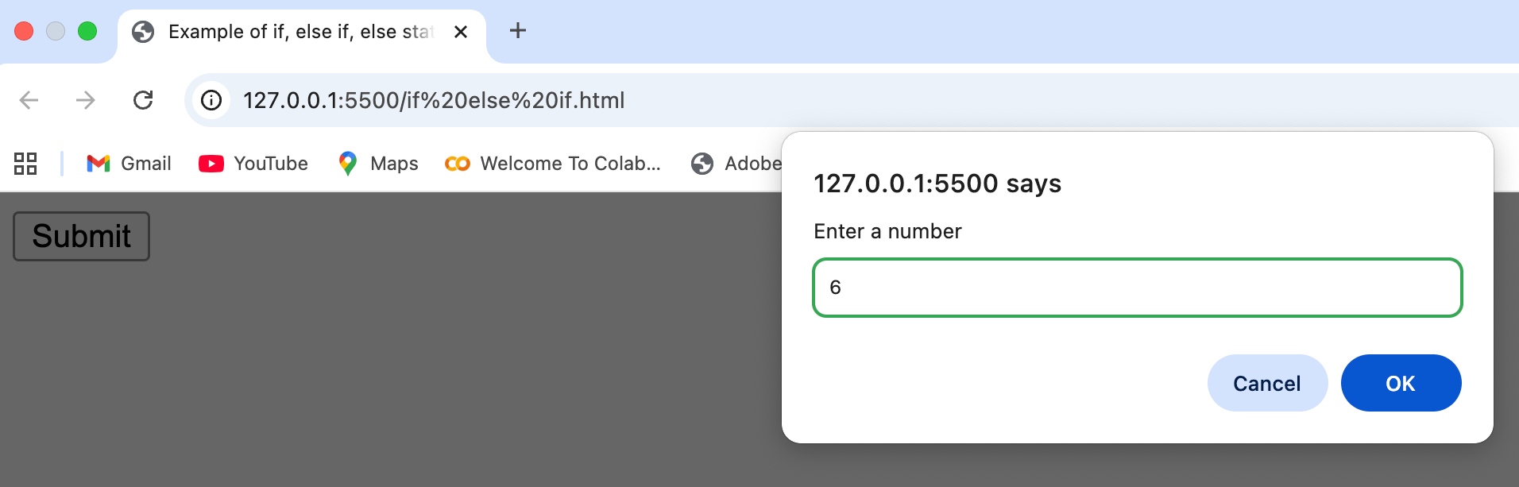
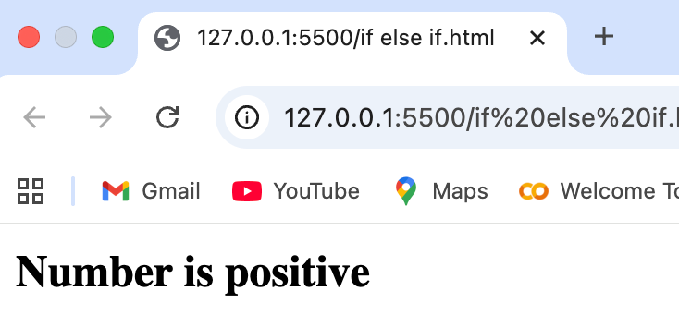
QN 4Write a Js Program to demonstrate an example of control statement using if(), elseif() and else statement.
<html>
<head>
<title> Example of if, else if, else statement</title>
<script>
function pnz()
{var num=parseInt(prompt("Enter a number"));
if(num <0)
document.write("<b>Number is negative</b>");
else if(num>0)
document.write("<b>Number is positive</b>");
else
document.write("<b>Number is zero</b>");
}
</script>
</head>
<body>
<input type = "button" onclick = "pnz()" value = "Submit" />
</body>
</html>

Slide 6
QN 5 Write a Js Program to demonstrate an example of menu based program using switch case statement.
case 5:
document.write("Thursday");
break;
case 6:
document.write("Friday");
break;
case 7:
document.write("Saturday");
break;
default: document.write("invalid day Please choose from 1-7");
break
}
}
</script>
</head>
<body>
<input type="button" value="day" onclick=”menu()">
</body>
</html>
<html>
<head>
<title> example menu based program using switch case</title>
<script>
function menu()
{var day=parseInt(prompt("enter the day"));
switch(day)
{
case 1:
document.write("Sunday");
break;
case 2:
document.write("Monday");
break;
case 3:
document.write("Tuesday");
break;
case 4:
document.write("Wednesday");
break;

Slide 7
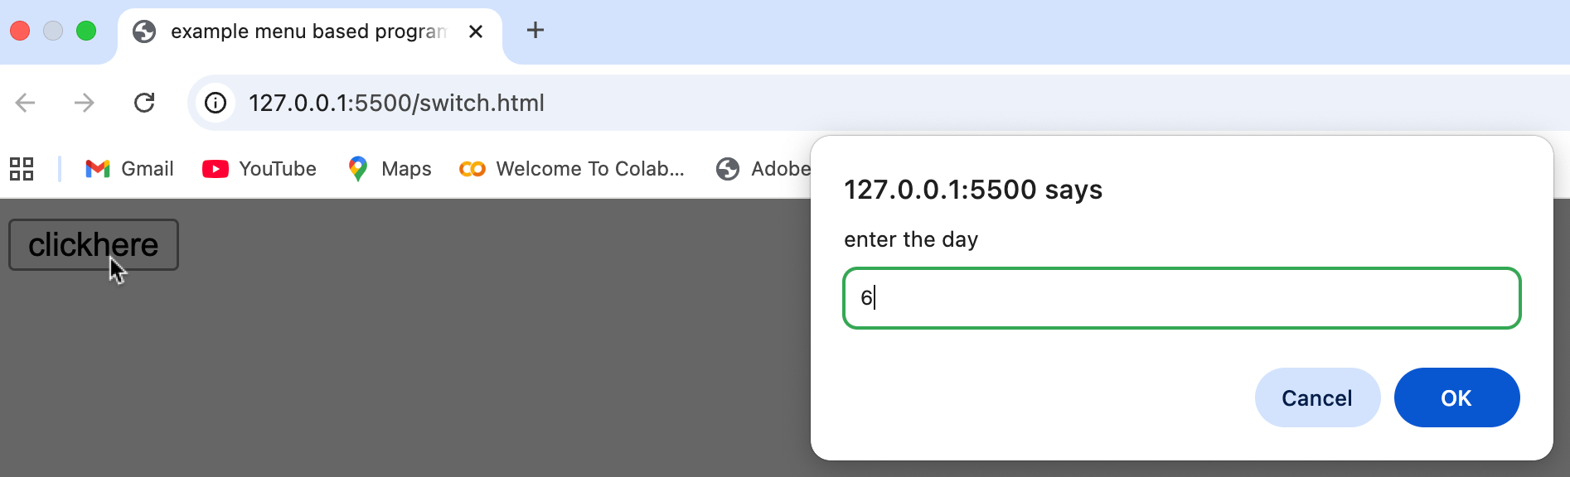
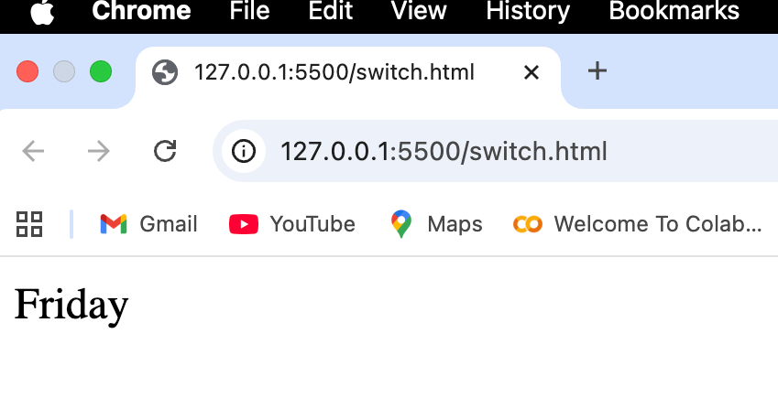
Output of Q 5

Slide 8
QN 4 Write a Js Program to demonstrate an example of loop to demonstrate first ‘n’ natural no.
<html>
<head>
<title> example to print first n natural no:</title>
<script>
function natural()
{ var i;
var n=parseInt(prompt("enter the number"));
for (i=1; i<=n; i++)
{
document.write(i + "<br/>");
}
}
</script>
</head>
<body>
<input type="button" value="clickhere" onclick="natural()">
</body>
</html>

Slide 9
